Slide 1
Systems of Linear Equations in Two Variables

Slide 2
Systems of Linear Equations in Two Variables
Recall that an equation of the form Ax + By = C is a linear
equation in two variables.
A solution of a linear equation in two variables is an ordered pair (x, y) that makes the equation a true statement.
For example, (–2, 3) is a solution of the equation
2x + 3y = 5 because 2(–2) + 3(3) = 5
The graph of a linear equation in two variables, a straight line, is the set of points whose ordered pairs satisfy the equation.

Slide 3
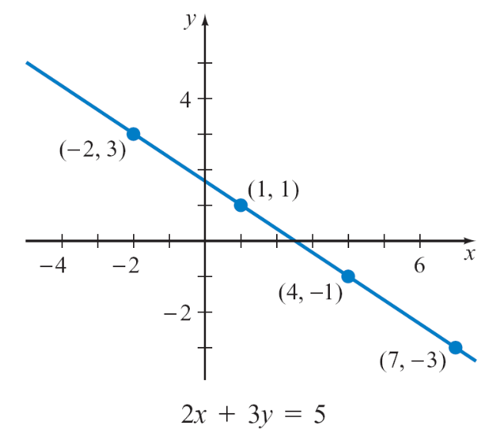

Systems of Linear Equations in Two Variables
Figure 9.1 is the graph of 2x + 3y = 5.
A system of equations is two or more equations considered together.
The following system of equations
is a linear system of equations
in two variables.
2x + 3y = 4
3x – 2y = –7
A solution of a system of equations
in two variables is an ordered pair that
is a solution of both equations.
Figure 9.1

Slide 4
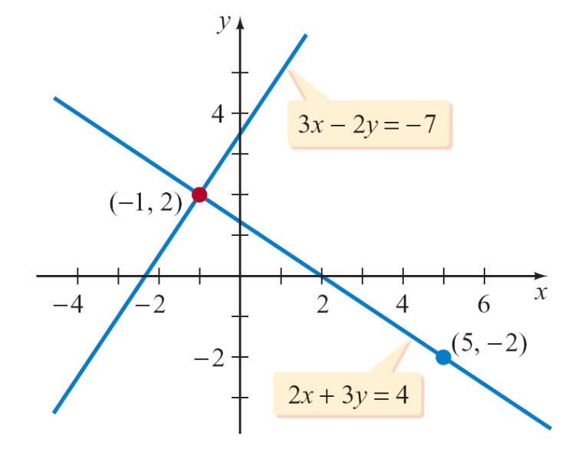
Systems of Linear Equations in Two Variables
In Figure 9.2, the graphs of the two equations in the system of equations above intersect at the point (–1, 2).
Because that point lies on both
lines, (–1, 2) is a solution of both
equations and thus is a solution
of the system of equations.
The point (5, –2) is a solution of
the first equation but not a solution
of the second equation. Therefore,
(5, –2) is not a solution of the
system of equations.
Figure 9.2

Slide 5
Systems of Linear Equations in Two Variables
A system of equations is a consistent system if it has
at least one solution.
A system of equations with no solution is an inconsistent
system.
A system of linear equations with exactly one solution is
an independent system.
A system of linear equations with an infinite number of
solutions is a dependent system.

Slide 6
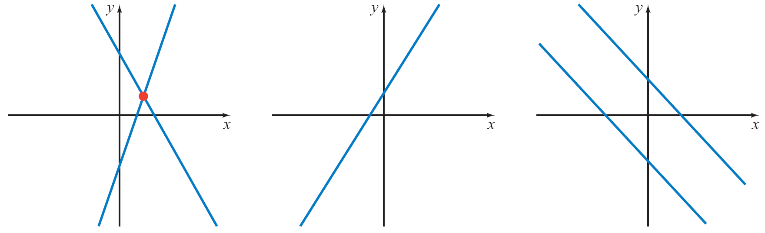
Systems of Linear Equations in Two Variables
The graphs of the two equations in a linear system of two variables can intersect at a single point, be the same line,
or be parallel lines. See Figure 9.3.
The graphs intersect
at a single point.
Both equations graph
to be the same line.
The graphs are
parallel lines.
a. Independent system
Exactly one solution
b. Dependent system
Infinitely many solutions
c. Inconsistent system
No solution
Figure 9.3

Slide 7
Substitution Method for Solving a System of Equations

Slide 8

Example 1 – Solve a System of Equations by the Substitution Method
Solve: 3x – 5y = 7 (1)
y = 2x (2)
Solution:
The solutions of y = 2x are the ordered pairs (x, 2x). For the system of equations to have a solution, ordered pairs of the form (x, 2x) also must be solutions of 3x – 5y = 7.
To determine whether the ordered pairs (x, 2x) are solutions of Equation (1), substitute (x, 2x) into Equation (1) and solve for x. Think of this as substituting 2x for y.

Slide 9
Example 1 – Solution
cont’d
3x – 5y = 7
3x – 5(2x) = 7
3x – 10x = 7
–7x = 7
x = –1
y = 2x
= –2
The only solution of the system of equations is (–1, –2). You can check your work by showing that (–1, –2) satisfies both equations in the original system.
Equation (1)
Substitute 2x for y.
Solve for x.
Equation (2)
= 2(–1)
Substitute –1 for x in Equation (2).

Slide 10
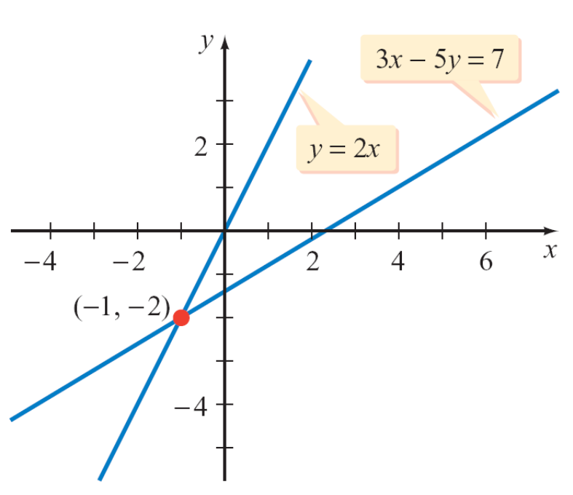
Example 1 – Solution
cont’d
Graphing 3x – 5y = 7 and y = 2x shows that the point
(–1, –2) belongs to both lines. Therefore, (–1, –2) is a solution of the system of equations.
An independent system of equations

Slide 11
Elimination Method for Solving a System of Equations

Slide 12

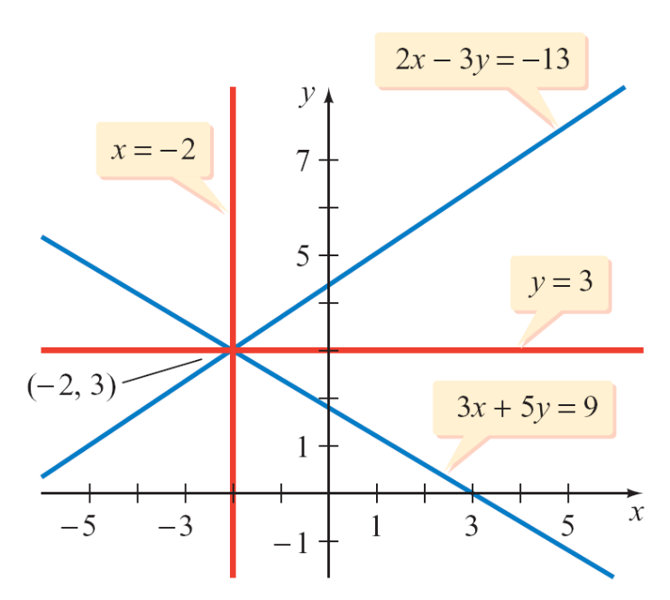
Elimination Method for Solving a System of Equations
Two systems of equations are equivalent if the systems
have exactly the same solutions. The systems
3x + 5y = 9 x = –2
2x – 3y = –13 y = 3
are equivalent systems of
equations. Each system has
the solution (–2, 3), as shown
in Figure 9.5.
and
Figure 9.5

Slide 13
Elimination Method for Solving a System of Equations
A second technique for solving a system of equations is
similar to the strategy for solving first-degree equations in
one variable.
The system of equations is replaced by a series of equivalent systems until the solution is apparent.
Operations That Produce Equivalent Systems of Equations
1. Interchange any two equations.
2. Replace an equation with a nonzero constant multiple of that equation.

Slide 14
Elimination Method for Solving a System of Equations
3. Replace an equation with the sum of that equation and a
nonzero constant multiple of another equation in the
system.
Because the order in which the equations are written does not affect the system of equations, interchanging the equations does not affect its solution.
The second operation restates the property that multiplying each side of an equation by the same nonzero constant does not change the solutions of the equation.

Slide 15
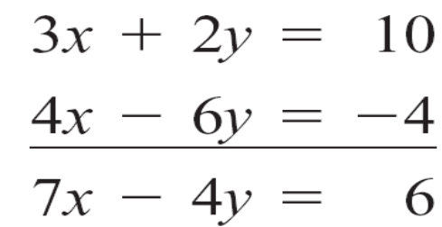
Elimination Method for Solving a System of Equations
The third operation can be illustrated as follows. Consider
the system of equations
3x + 2y = 10 (1)
2x – 3y = –2 (2)
Multiply each side of Equation (2) by 2. (Any nonzero number would work.) Add the resulting equation to
Equation (1).
(3)
Equation (1)
2 times Equation (2)
Add the equations.

Slide 16

Elimination Method for Solving a System of Equations
Replace Equation (1) with the new Equation (3) to produce
the following equivalent system of equations.
7x – 4y = 6 (3)
2x – 3y = – 2 (2)
The third property states that the resulting system of equations has the same solutions as the original system
and is therefore equivalent to the original system of equations.

Slide 17
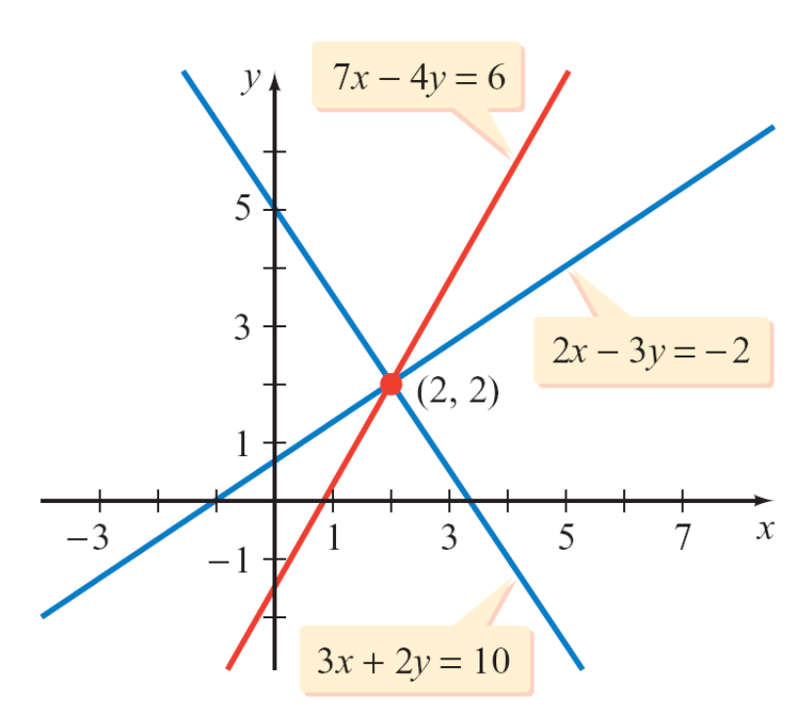
Elimination Method for Solving a System of Equations
Figure 9.6 shows the graph of 7x – 4y = 6. Note that this line passes through the same point at which the lines of the original system of equations intersect, the point (2, 2).
Figure 9.6

Slide 18


Example 4 – Solve a System of Equations by the Elimination Method
Solve: 3x – 4y = 10 (1)
2x + 5y = –1 (2)
Solution:
Use the operations that produce equivalent equations to eliminate a variable from one of the equations.
Alternative to Example 4
Solve: 8x + 5y = 9 (1)
3x – 2y = –16 (2)
(–2, 5)

Slide 19
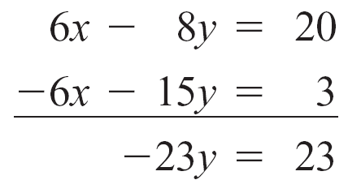

Example 4 – Solution
cont’d
We will eliminate x from Equation (2) by multiplying each
equation by a different constant so as to create a new
system of equations in which the coefficients of x are
additive inverses.
2 times Equation (1)
–3 times Equation (2)
Add the equations.
Solve for y.

Slide 20
Example 4 – Solution
cont’d
Solve Equation (1) for x by substituting –1 for y.
3x – 4(–1) = 10
3x = 6
x = 2
The solution of the system of equations is (2, –1).

Slide 21
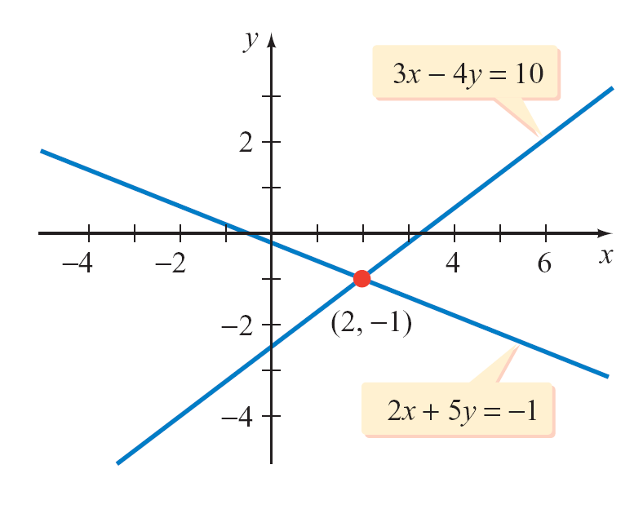
Example 4 – Solution
cont’d
Graphing 3x – 4y = 10 and 2x + 5y = –1 shows that (2, –1) is
the only point that belongs to both lines.
Therefore, (2, –1) is the solution of the system of equations.

Slide 22
Elimination Method for Solving a System of Equations
The method just described is called the elimination method
for solving a system of equations, because it involves
eliminating a variable from one of the equations.

Slide 23
Applications of Systems of Equations

Slide 24
Applications of Systems of Equations
Consider the situation of a Corvette car dealership. If the dealership were willing to sell a Corvette for $10, there would be many consumers willing to buy a Corvette.
The problem with this plan is that the dealership would soon be out of business. On the other hand, if the dealership tried to sell each Corvette for $1 million, the dealership would not sell any cars and would still go out of business.
Between $10 and $1 million, there is a price at which a dealership can sell Corvettes (and stay in business) and at which consumers are willing to pay that price. This price is referred to as the equilibrium price.

Slide 25
Applications of Systems of Equations
Economists refer to these types of problems as supply–
demand problems. Businesses are willing to supply a
product at a certain price, and there is consumer demand for
the product at that price.
To find the equilibrium point, a system of equations is
created. One equation of the system is the supply model of
the business. The second equation is the demand model of
the consumer.

Slide 26

Example 6 – Solve a Supply–Demand Problem
Suppose that the number x of bushels of apples a farmer is willing to sell is given by x = 100p – 25, where p is the price, in dollars, per bushel of apples. The number x of bushels of apples a grocer is willing to purchase is given by
x = –150p + 655, where p is the price per bushel of apples. Find the equilibrium price.
Solution:
Using the supply and demand equations, we have the system of equations
x = 100p – 25
x = –150p + 655

Slide 27
Example 6 – Solution
cont’d
Solve the system of equations by using substitution.
–150p + 655 = 100p – 25
–250p + 655 = –25
–250p = – 680
p = 2.72
The equilibrium price is $2.72 per bushel.
Subtract 100p from each side.
Subtract 655 from each side.
Divide each side by –250.

